Slide 1
Microinteractions Redesign
Mobile Application Komoot
Prototyping of Interactive Systems
18th of January, 2024
Iris de Wit

Slide 2
01
Intro and
Macro design

Slide 3
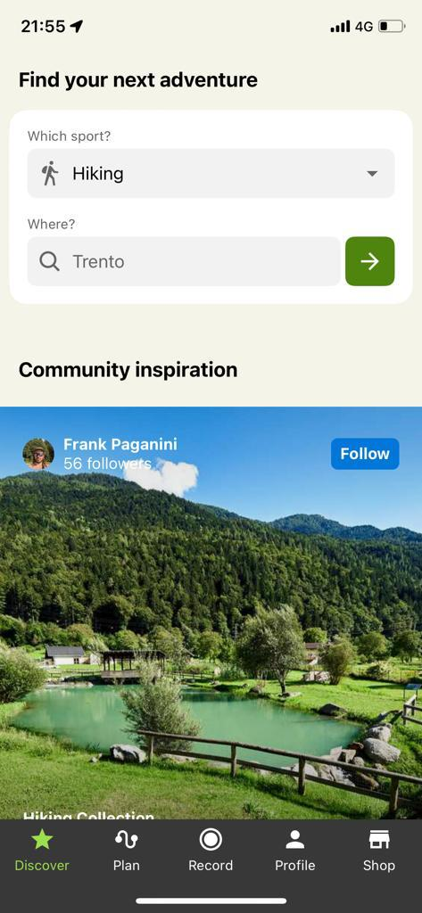

Komoot is a navigation and route planning application designed for outdoor enthusiasts, offering features such as trail discovery, GPS navigation, and community engagement for activities like hiking, cycling, and running.
Accessible as Web and Mobile application.

Slide 4
Functionalities
1
Discovery and Exploration: Discover new routes, places of interest, and outdoor destinations by help of the application.
2
Route Planning: Plan a new route for outdoor activities like hiking, cycling, or running.
3
Recording and Navigation: Users can follow a planned route with turn-by-turn navigation, and record without planning a route.
4
Activity tracking: Track and analyze outdoor activities, including past and ongoing workouts.
5
Social Interaction: Share activities and connect with the Komoot community.

Slide 5
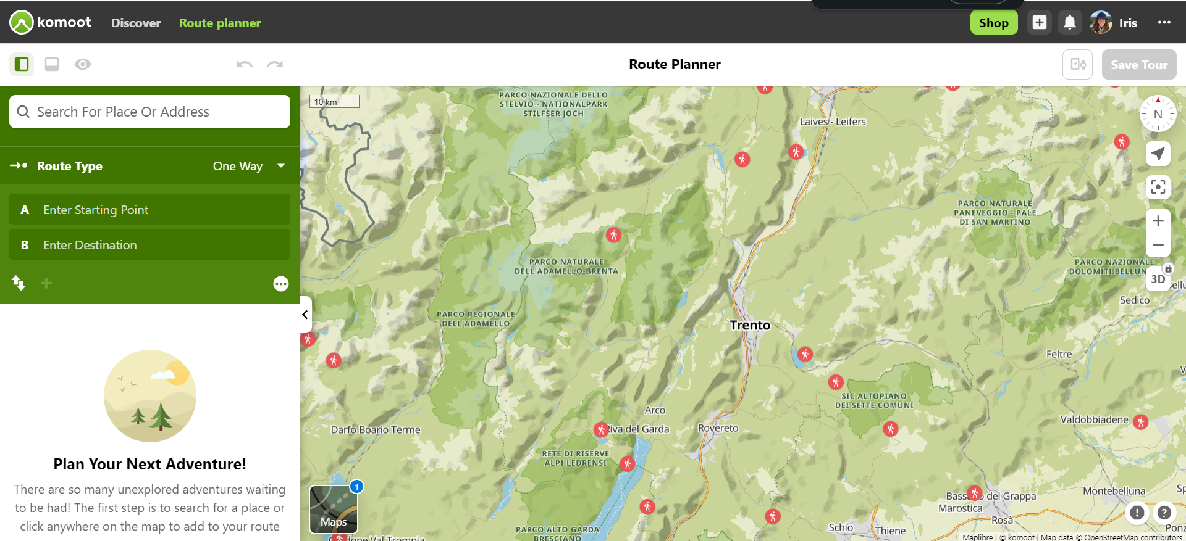
Komoot’s Platforms and Postures
Web App
Mobile Application

Slide 6
Komoot’s Platforms and Postures
Mobile Application
Nature of Interaction: Komoot serves as a navigation and route planning application, where users engage in specific tasks such as planning a route or navigating to a destination. These are transient activities that users typically complete relatively quickly.
Goal-Oriented: Users of Komoot usually have a specific goal in mind, such as planning a hiking or biking route. Once the goal is achieved, the interaction with the app is often concluded.
Interface Design: Komoot's interface is likely designed to be clear, intuitive, and focused on guiding users through the process of planning a route. The design would prioritize simplicity and efficiency for users who are on the app to accomplish a specific task.
Limited Controls: The controls and options presented to users in Komoot are likely constrained to the specific functions needed for route planning and navigation, aligning with the characteristics of a transient posture.
User Familiarity: While users may become familiar with the app through repeated use, the nature of each interaction remains task-specific, and users may not spend extended periods within the app.
In summary, Komoot's primary posture appears to be transient, as users engage with the app for goal-oriented, task-specific activities related to route planning and navigation.

Slide 7
Komoot’s Platforms and Postures
Web App
Sovereign Posture for Komoot Web Application:
Extended Engagement: Users accessing Komoot through the web may engage with the application for extended periods, especially when planning routes, exploring maps, or reviewing detailed information. This aligns with the characteristics of a sovereign posture.
Rich Interaction: The web application may provide a more extensive and feature-rich interface compared to the mobile version, allowing users to explore maps, review route details, and customize their experience. This richness aligns with the characteristics of a sovereign posture.
Workspace Customization: Users on the web application may benefit from a larger screen real estate, allowing for more workspace customization. Sovereign postures often involve providing users with the ability to customize their workspace for increased efficiency.
Transient Posture for Komoot Web Application:
Task-Oriented Actions: Users on the web application may still engage in task-oriented actions, such as planning specific routes or checking route details. These actions are transient in nature, aligning with the characteristics of a transient posture.
Clear and Intuitive Design: The web application would likely maintain a clear and intuitive design, especially for users who want to perform specific tasks efficiently. This is in line with the principles of a transient posture.
Goal Achievement: Users accessing the web application may have specific goals, such as planning a route for an upcoming trip. Once these goals are achieved, the interaction with the app may conclude, reflecting the transient nature.

Slide 8
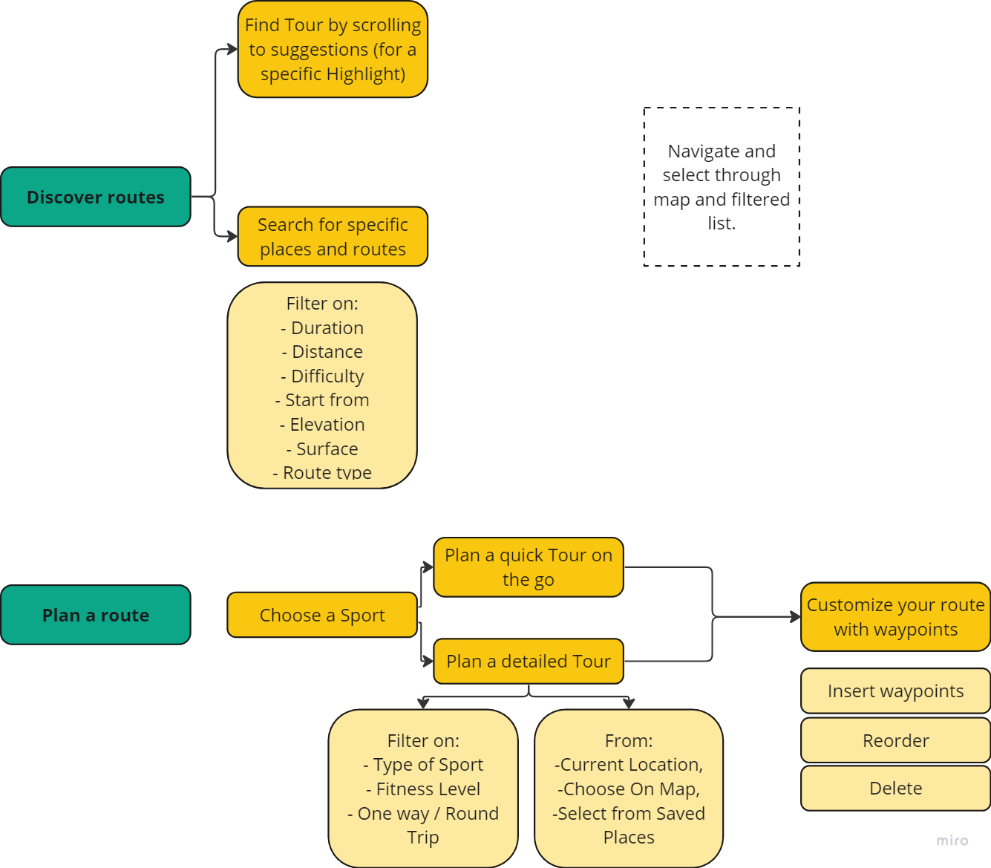
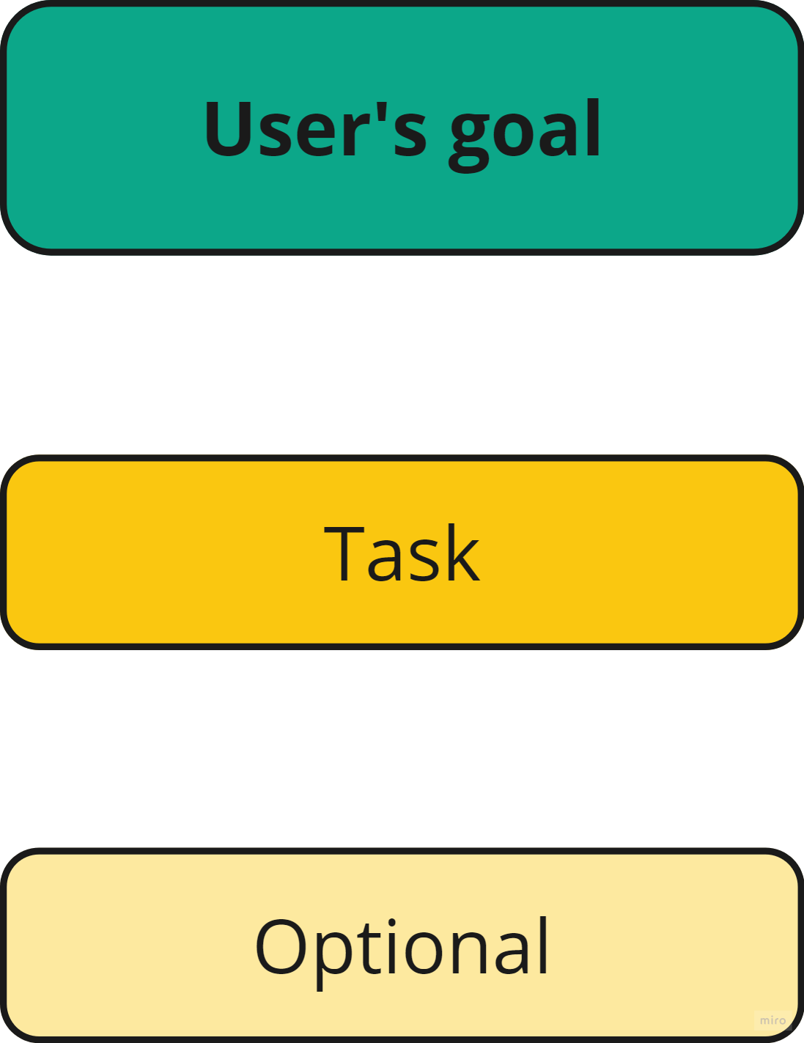
Komoot Macrointeractions 1/2

Slide 9
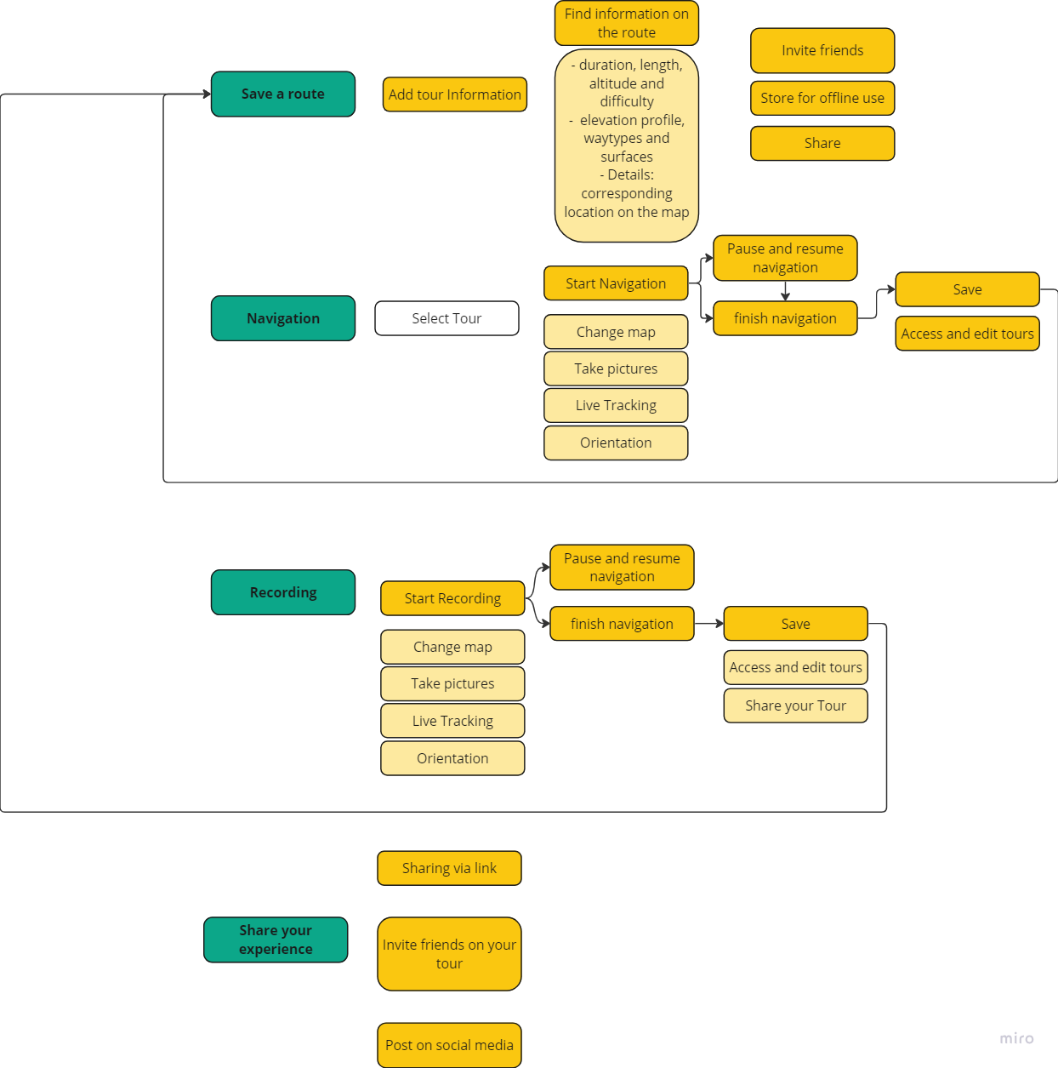
Komoot Macrointeractions 2/2

Slide 10
Supporting Users
All users are sport enthusiasts wanting to explore and plan their routes.
On-the-go
Organized
End goal
Making the interface intuitive, engaging, and efficient.
Wanting to explore their surroundings by taking routes around them, as quickly as possible
Who would like to plan routes in advance and take many aspects into account before going, going for a detailed approach.
Creating more efficient interactions, with multiple facets in one page, less navigation between pages
Adding details and specifications such that the user can start their route very prepared.

Slide 11
02
Microinteractions

Slide 12
Microinteractions overview
#1 Select a sport | #1.1 Horizontal Scrollable Carousel
 | #1.2 Segmented Control
 | #1.3 Radio Button
 | #1.4 Tuggle Button
#2 Select location (around current location) | #2.1 Search Bar navigation to search page
 | #2.2 Radius slider
 | #2.2b Direct Manipulation
 | #2.2c Distance Input Box
#3 Specifications for found routes | #3.1 Filter at main page
 | #3.1b Dropdown
 | #3.1c Horizontal Scrolling

Slide 13
Microinteractions overview
#4 Filtering Distance and Duration | #4.1 Segmented Control
 | #4.2 Reactive Sliders
 | #4.3 Input Field
 | #4.4 Time Filter Chip Bar
#5 Filtering Difficulty | #5.1 Circular Proress Bar
 | #5.2 Dropdown Menu
#6 Filtering Surface | #6.1 Image-Selection Block
 | #6.2 Dropdown Menu
#7 Organization Community | #7.1 LATCH Category
 | #7.2 Sorting Filter
 | #7.2b Icon Dropdown
 | #7.2c Icon Dropdown Label

Slide 14
Microinteractions overview
#8 Fitness Level | #8.1 Slider
 | #8.2 Circular Dial
 | #8.3 Segmented Control
 | #8.4 Dropdown
#9 One Way or Round Trip | #9.1 Immediate Segmented Control
 | #9.2 Placeholder / Error message
#10 Choose Starting Point | #10.1 Segmented Control Map/List
 | #10.1b Dropdown route in Map
#11 Search Bar | #11.1 Horizontal Scrolling
 | #11.2 Highlights LATCH Hierarchy
 | #11.3 Informative Tooltip
 | #11.4 Search LATCH

Slide 15
Microinteractions overview
#12 Search on Map | #12.1 Special places Horizontal bar
 | #12.1b LATCH Hierarchical
 | #12.2 Visual Click-responsive Highlight
#13 Manipulate existing Route | #13.1 Buttons
 | #13.2 Dropdown
 | #13.2b Icon Dropdown
 | #13.3 Drag and Drop
#14 Edit / Adjust Route | #14.1 Dropdown Editable Waypoints
 | #14.1b Providing Info Button
 | #14.2 Direct Manipulation Edit

Slide 16
Microinteractions overview
Total Alternatives: 50
#15 Record Route | #15.1 Expandable Bottom Bar
 | #15.2 Segmented Control
 | #15.3 Feedback Finished Tour
 | #15.3b Feedback Default

Slide 17
Microinteractions Discover Page
The Discover feed is the go-to place for users seeking inspiration for their next adventures.
They can scroll through personalized content or use the search for Tour suggestions in a specific region.

Slide 18
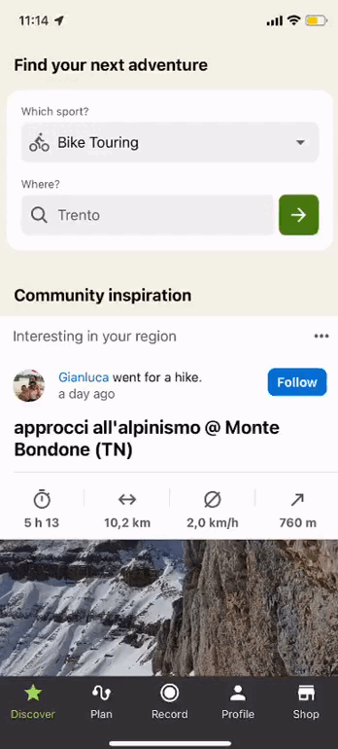
#1
Select a Sport
Discover
original
Description:
Interaction goal:
The original microinteraction is a drop down menu showing the different types of sports. It allows only to search for one sport at the time.
Selecting one type of sport to find the user’s next adventure and routes already existing in Komoot.

Slide 19
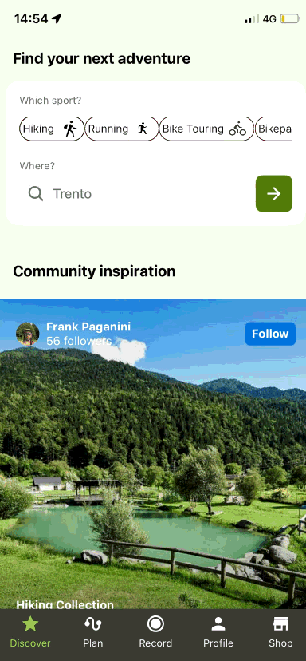
#1.1
Horizontal Scrollable Carousel
Discover
alternative
Description:
Goal and motivation:
Instead of a dropdown, users can scroll horizontally through a visually presented set of sport icons and labels.
Provides a more visually engaging and dynamic interaction.
Allows users to quickly swipe or scroll through options.
Reduces the need for additional clicks, providing a more efficient selection process. Later, there are more alternative horizontal scrollable carousels, making it more consistent helping for learnability (new users) and memorability (for users in the long run).

Slide 20
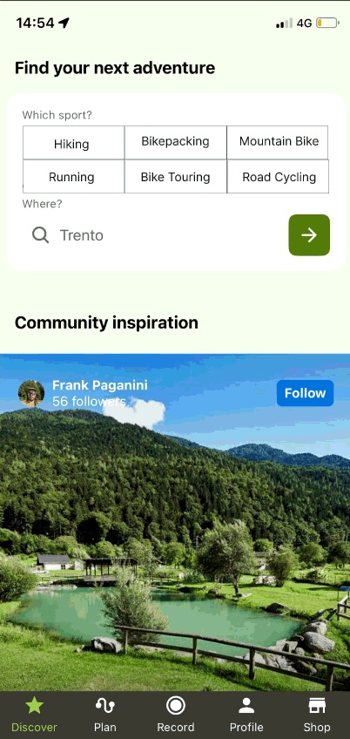
#1.2
Segmented Control
Discover
alternative
Description:
Goal and motivation:
A segmented control consists of a set of individual segments, each representing a specific sport. Users can tap on the desired segment to make their selection. Allowing users to select multiple sports.
Offers a more compact and visually clear interface.
Enables users to make selections for multiple sports to discover even more, making it interesting for the exploring users, open for multiple outcomes.

Slide 21
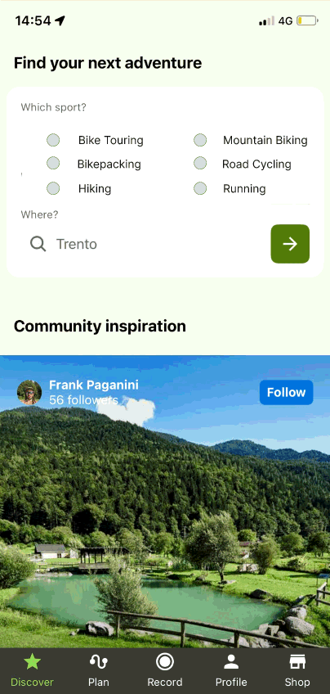
#1.3
Radio Button
Discover
alternative
Description:
Goal and motivation:
Instead of a dropdown, present a set of radio buttons or toggle buttons, each representing a specific sport option (e.g., Hiking, Bike Touring, Road Cycling, etc.).
Provides a visual representation of each sport option.
Allows users to directly click or tap on their preferred sport without the need for an additional interaction to open a dropdown.

Slide 22
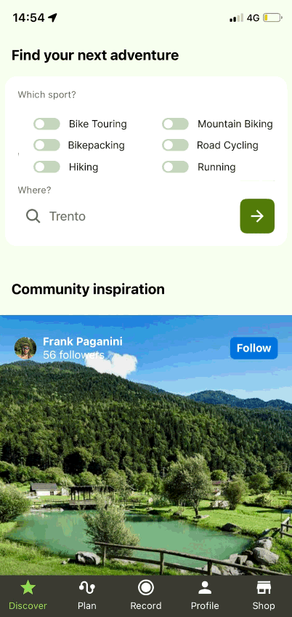
#1.4
Toggle Button
Discover
alternative
Description:
Goal and motivation:
The difference with the radio button is that in this variation it is also possible to explore multiple sports.
Provides a visual representation of each sport option.
Allows users to directly click or tap on their preferred sport without the need for an additional interaction to open a dropdown, contributing to efficiency. Creating an option to select multiple sports can be beneficial for explorative users or users who want a detailed overview.

Slide 23
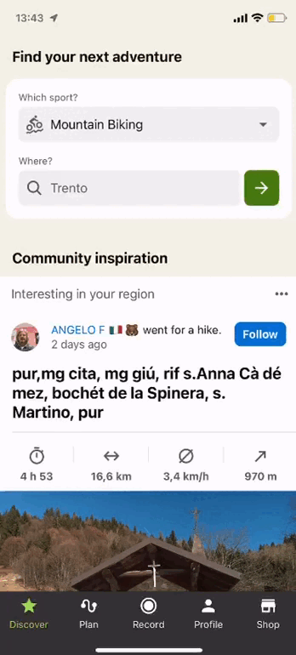
#2
Select Location
(around current location)
Discover
original
Description:
Interaction goal:
The original microinteraction is a search bar with as default the user’s location. By selecting the green arrow button while staying with the default mode, the user is first asked to “Current location” or “Surrounding area”. Otherwise the user can type another location in the search bar.
Selecting a location to discover certain routes around.

Slide 24
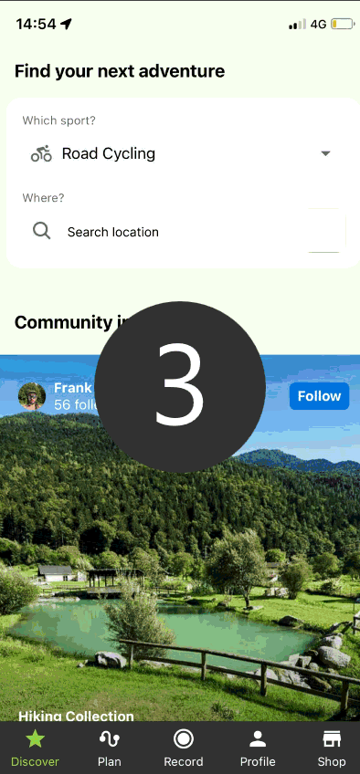
#2.1
Search bar directly to search page
Discover
alternative
Description:
Goal and motivation:
Instead of defaulting to the user's current location and requiring an additional action to choose a distance range, the direct action leads users to the search page from where the user has multiple options.
Efficiently streamline location selection by replacing the default option with a direct action leading to the search page, aiming to enhance user experience through a more intuitive and hassle-free process.

Slide 25
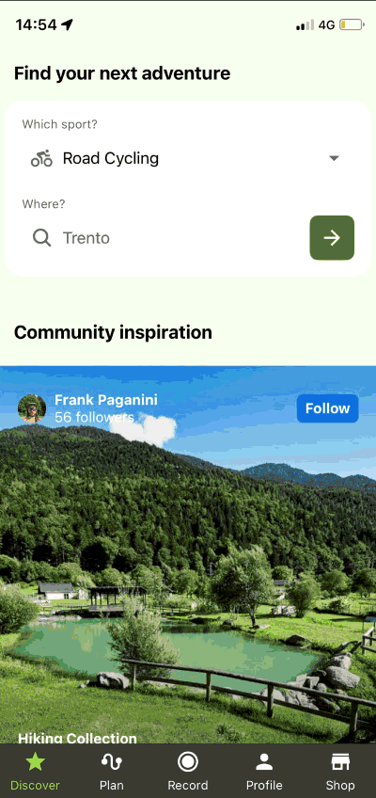
#2.2
Radius slider to control distance
Discover
alternative
Description:
Goal and motivation:
Instead of asking for closer or further away from a position, the user has the option to use a slider control that allows users to visually adjust the search radius. Users can slide the control to increase or decrease the radius based on their preferences.
Offers a visual and intuitive way for users to set the radius.
Provides real-time feedback on the selected radius making it more intuitive.

Slide 26
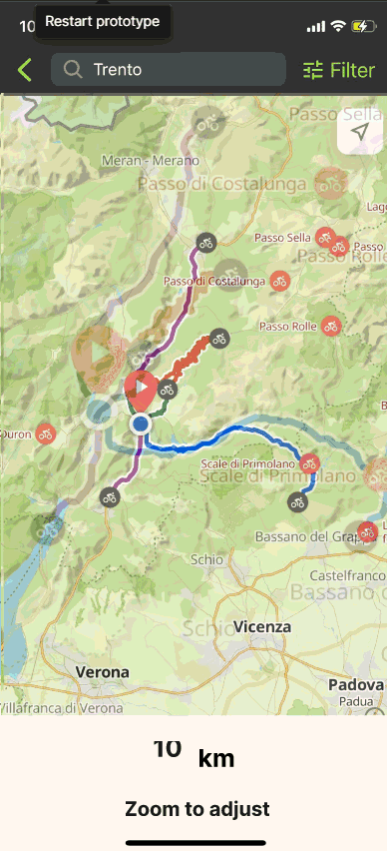
#2.2b
Direct Manipulation
Discover
alternative
Description:
Goal and motivation:
Allow users to perform a pinch-to-zoom gesture on a map to adjust the search radius visually. Pinching in or out on the map adjusts the radius accordingly.
Utilizes a familiar and natural gesture for radius adjustment.
Offers a dynamic and interactive experience.

Slide 27
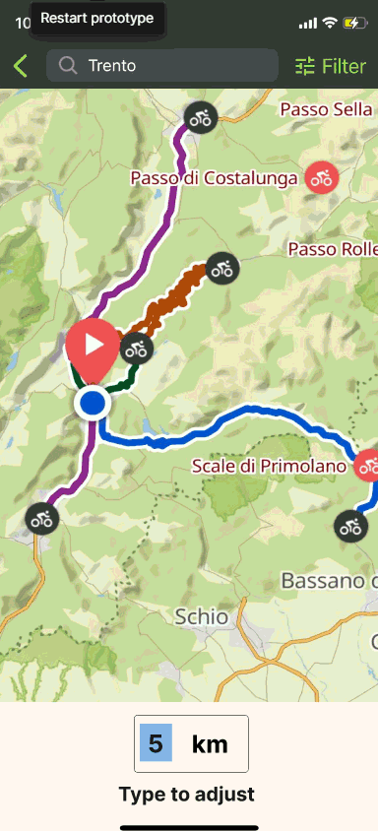
#2.2c
Distance Input Box
Discover
alternative
Description:
Goal and motivation:
Allows users to input the desired radius manually through a numeric input field. This gives them precise control over the search radius.
Enables users to enter an exact radius value.
Suitable for users who prefer numeric input or have a specific radius in mind.

Slide 28
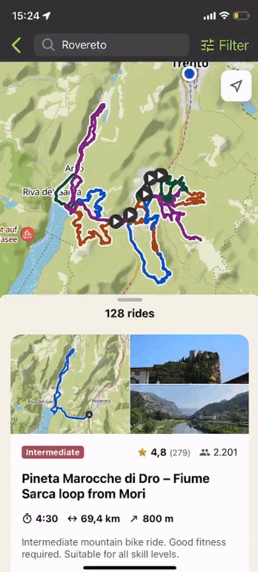
#3
Filters for found routes in Discovery
Discover
original
Description:
Interaction goal:
The original microinteraction is a filter option after the sport and location are selected, including:
Distance / Duration
Difficulty
Elevation
Surface
Route type
Allowing users to specify their route preferences.

Slide 29
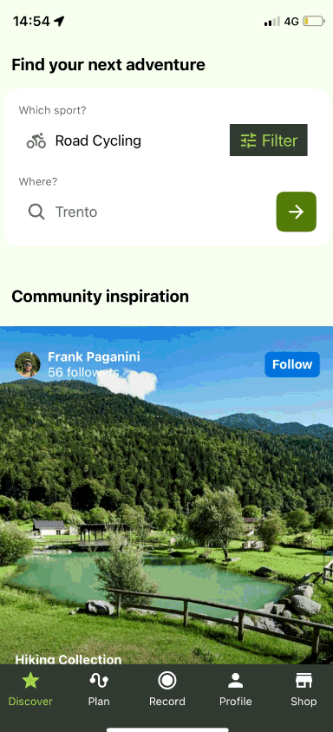
#3.1
Filter at main page
Discover
alternative
Description:
Goal and motivation:
Introduces a microinteraction enabling users to apply filters directly on the home page, simplifying the process. Users can instantly customize content without navigating to a separate filter page.
Streamlines user journey, eliminating extra steps.
Enhances personalization with immediate customization.
Makes it faster for on-the-go users and more complete search directly for organized users.

Slide 30
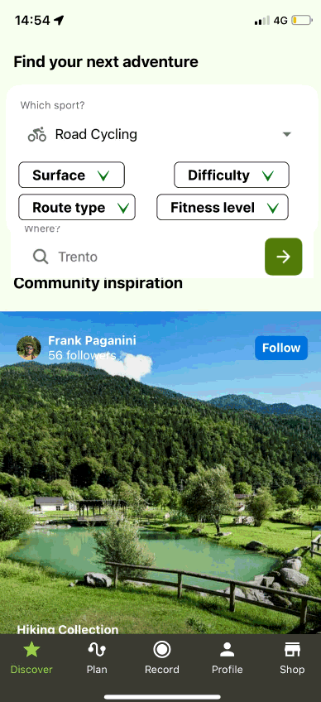
#3.1b
Dropdown options
Discover
alternative
Description:
Goal and motivation:
Enable users to interactively adjust filter options on the main screen by incorporating in-screen dropdown menus. Users can effortlessly explore and modify filters without the need to access a separate page. Gives direct feedback when option is selected.
Seeks to streamline the user experience by integrating in-screen dropdowns, providing an immediate and accessible method for users to personalize content.

Slide 31
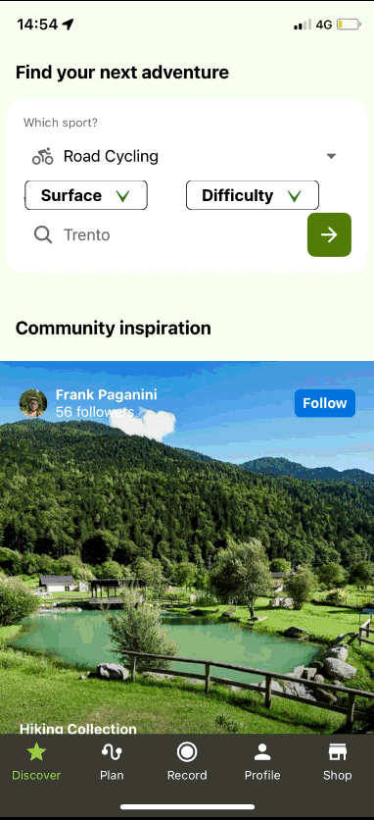
#3.1c
Horizontal scrolling
Discover
alternative
Description:
Goal and motivation:
Horizontal scrolling dropdown menu directly on the main screen, allowing users to smoothly navigate and select filter options without the need for additional pages, taking up less space in the screen.
The goal is to implement a filter showing all options into the main interface. Taking up less space makes it different from a more original dropdown. As multiple horizontal scrolling alternatives are provided, it also helps with consistency, making it easier for learnability, and memorability on the long run.

Slide 32
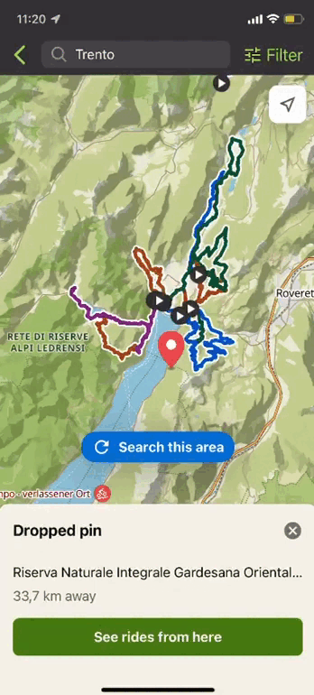
#4
Filtering Distance and Duration
Discover
original
Description:
Interaction goal:
The original microinteraction is a container with Duration which can be adapted by a slider. To filter by Distance, the user has to click “Filter by Distance".
As it is continuous data, the goal is to enhance user control and customization by enabling a slider-based adaptation for the "Duration" container. The user can base their filter options on which data they would like to filter.

Slide 33
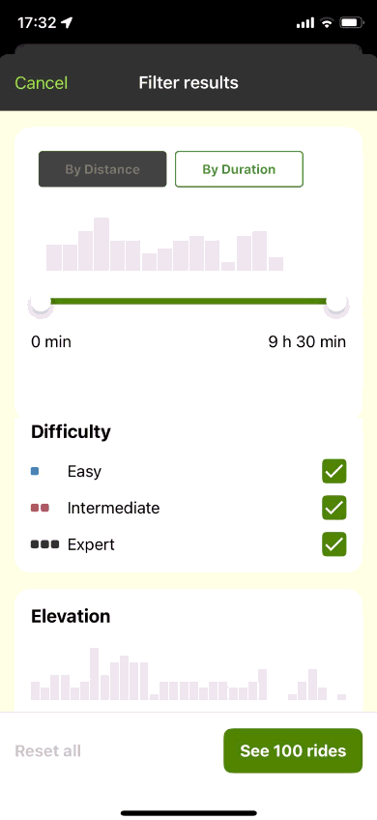
#4.1
Segmented Control
Discover
alternative
Description:
Goal and motivation:
A segment button labeled "Distance" to streamline the filtering process. Users can easily toggle between "Duration" and "Distance" views. Giving better direct visual feedback on the action (changing filter option).
A segmented control is commonly used to switch between different options or views which is the case in to achieve the goal of filtering how the user prefers.

Slide 34
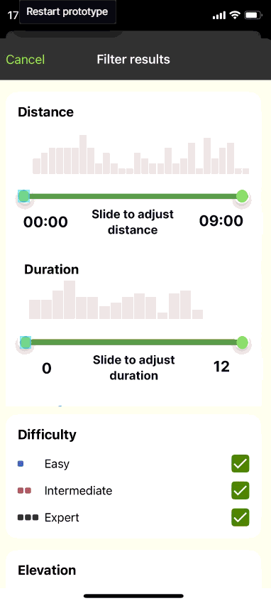
#4.2
Showing both filter options
with reactive sliders
Discover
alternative
Description:
Goal and motivation:
Showing both filter options where changing one slider automatically updates the other slider, which is not always one-to-one. They can filter how they prefer to have their ideal route.
Whereas before the distance and duration were not updated while switching, this shows that the filter options can be even more specified as the duration and distance are not always equally divided and now full information is shown, with less steps (clicking to see the other quantity). This is beneficial for the organized and detail-focused user.

Slide 35
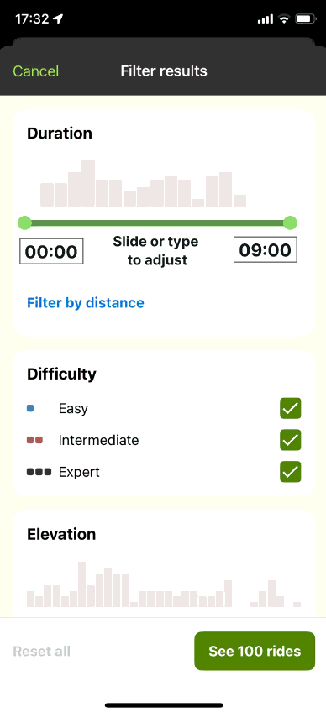
#4.3
Input field
Discover
alternative
Description:
Goal and motivation:
Apart from the slider to adjust distance or duration, there is an input field where the user can type a number. This can be used in the same way for Distance.
To have an input field next to a slider to quantify a number is useful for users as they have as many choices as they want to input. This increases user-control and error prevention if the user does not know how to use one of the input options.

Slide 36
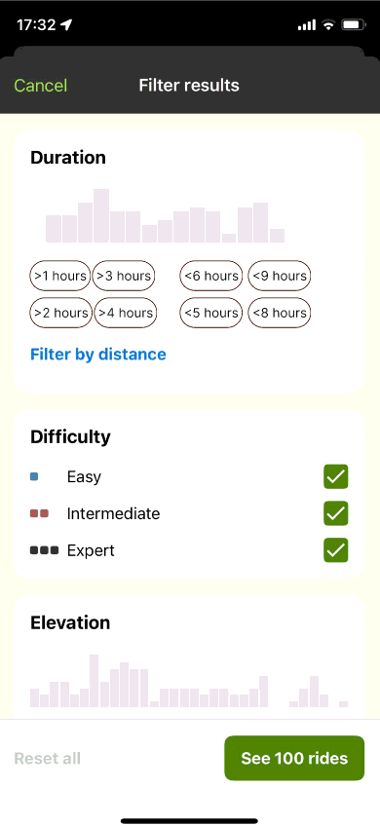
#4.4
Time Filter Chip Bar
Discover
alternative
Description:
Goal and motivation:
User interface element that includes chips for filtering content based on time-related criteria, allowing to classify certain time slots and thereby changing the filter options. While automatically updating the number of rides available.
Allowing a clicking interaction where the time slots are not continuous but classified, making it more simple to filter.

Slide 37
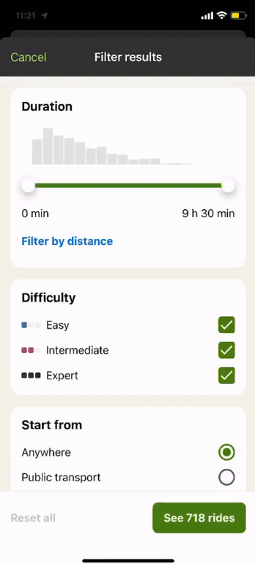
#5
Filtering Difficulty
Discover
original
Description:
Interaction goal:
The current microinteraction is a multi-select where you can select multiple difficulty levels (Easy, Intermediate, Expert) to filter the route on the level the user prefers.
Difficulty is classified in three levels and with a multi-select the user can select one, or two, or three of the difficulty levels, such that the user is free to select one or multiple.

Slide 38
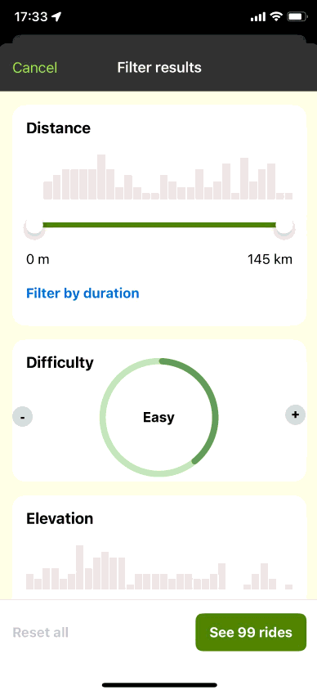
#5.1
Discover
Circular Progress Bar with
Stepped Values
alternative
Description:
Goal and motivation:
A circular progress bar with distinct stepped values, visually divided into segments. Users can progress through these predefined steps in a circular motion, reflecting the progress, with each step representing a difficulty category.
By progressing the circular bar from easy to intermediate, allows a direct visual feedback how far the difficulty level is progressed, matching the user’s mental model.

Slide 39
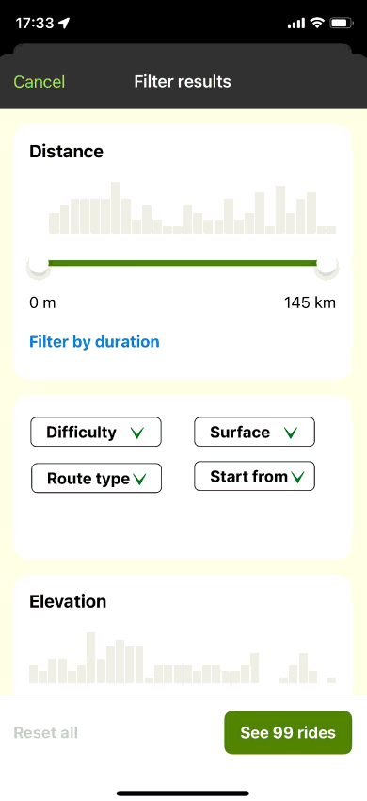
#5.2
Dropdown menu
Discover
alternative
Description:
Goal and motivation:
A Dropdown menu allows user to select one difficulty level.
To have a consistent experience with the other filter options Route type, Start from and Surface (see microinteraction 6.2) and by allowing users only to select one option leads to more simplicity. Once selected, the user sees the direct feedback in the field.

Slide 40
#6
Filtering Surface
Discover
original
Description:
Interaction goal:
The current microinteraction is a three-option list with radio buttons where you can select one type of surface (road or paved, Off-road) or no preference.
Radio buttons are designed to be mutually exclusive within a group. This ensures that users can only select one surface type at a time, preventing potential confusion or contradictory selections

Slide 41
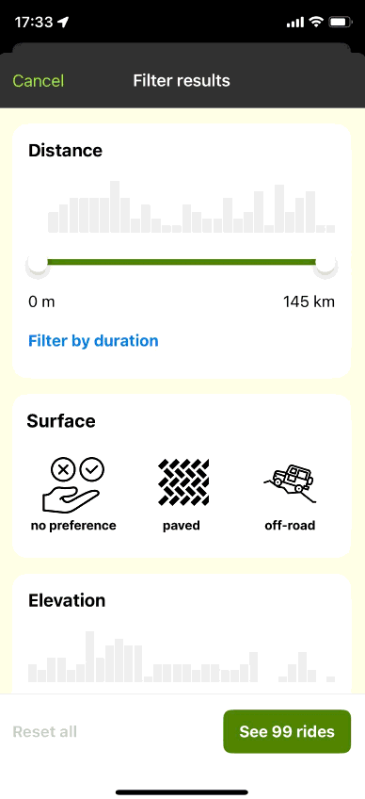
#6.1
Discover
Image-Selection Block
alternative
Description:
Goal and motivation:
A set of three images, each accompanied by a label, within a selectable block. Users can click or tap on the desired image to make a selection for surface type preferences.
This approach combines the efficiency of traditional radio buttons with a visually rich and modern design aesthetic, making it sometimes easier to choose for certain visual users. Easier for people who want to make quick decisions.

Slide 42
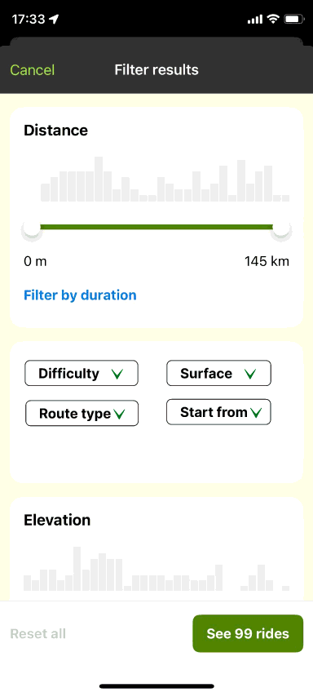
#6.2
Dropdown menu
Discover
alternative
Description:
Goal and motivation:
A Dropdown menu allows user to select one difficulty level.
To have a consistent experience with the other filter options Route type, Start from and Difficulty (see microinteraction 5.2) and by allowing users only to select one option leads to more simplicity. Once selected, the user sees the direct feedback in the field.

Slide 43
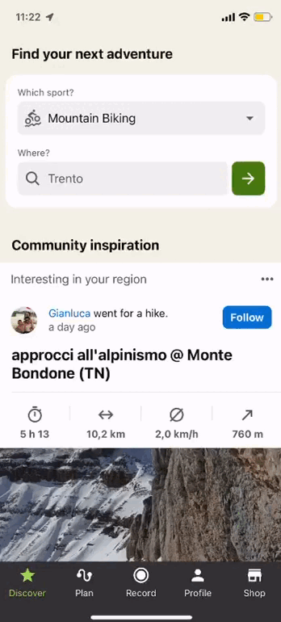
#7
Organization Community Organization
Discover
original
Description:
Interaction goal:
The Organization Community displays interesting routes for the user. The user can scroll through the content. They are randomly showed without any filtering or categorization.
Scrolling enables the user to see the image, some comments, the title, and different info depending on the origin of the information.

Slide 44
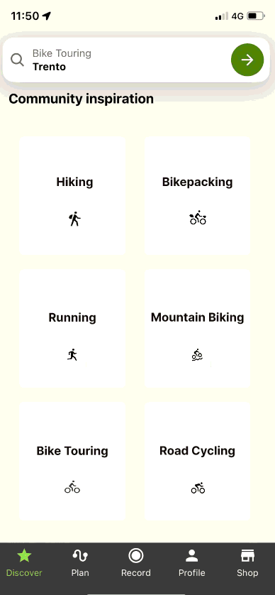
#7.1
LATCH by Category
Discover
alternative
Description:
Goal and motivation:
Latch by Category allows the user to have the content categorized by a certain sport serving as the category. Elements are grouped by similarity or relatedness.
This approach allows users to navigate and find content more easily, particularly when the categorical organization aligns with user mental models and expectations. This can be beneficial for the organized users who would like to see routes classified by activity.

Slide 45
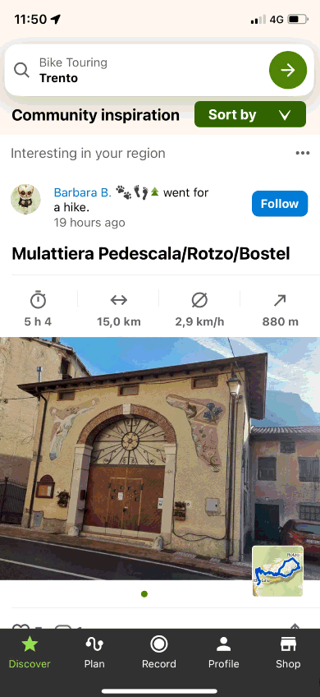
#7.2
Adding a Sorting Filter
Discover
alternative
Description:
Goal and motivation:
A sorting option allows the user to sort by:
Best Match
Most Popular
Closest
Newly Added
Scenic Rating
By sorting, each user can determine themselves what is most important for them, allowing them to make a personalized choice and have more control over content. By sorting it can be easier and more efficient to find inspiration what the user is looking for (on-the-go).

Slide 46
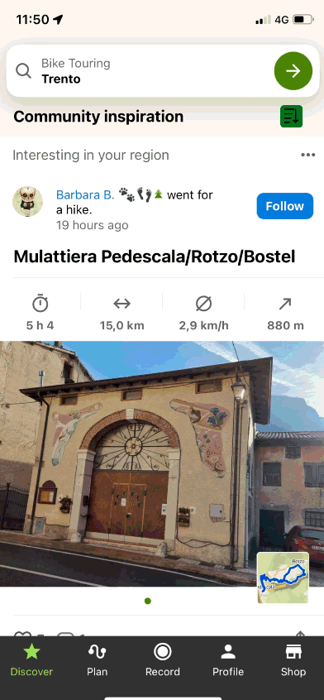
#7.2b
Icon Dropdown
Discover
alternative
Description:
Goal and motivation:
A sorting option allows the user to sort by the previously mentioned categories. This Icon Dropdown has the same functionality.
Choosing a dropdown with icons instead of labels for a visually appealing and space-efficient design, allowing for quick recognition, taking less space too.

Slide 47
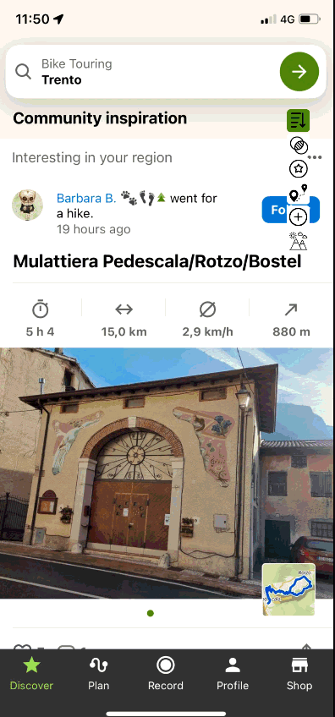
#7.2c
Icon Dropdown with label
Discover
alternative
Description:
Goal and motivation:
Same Icon Dropdown but now while hovering there’s an attached label to explain in words what each option shows.
Allowing the user to have more context on the action they take when selecting one of the options.

Slide 48
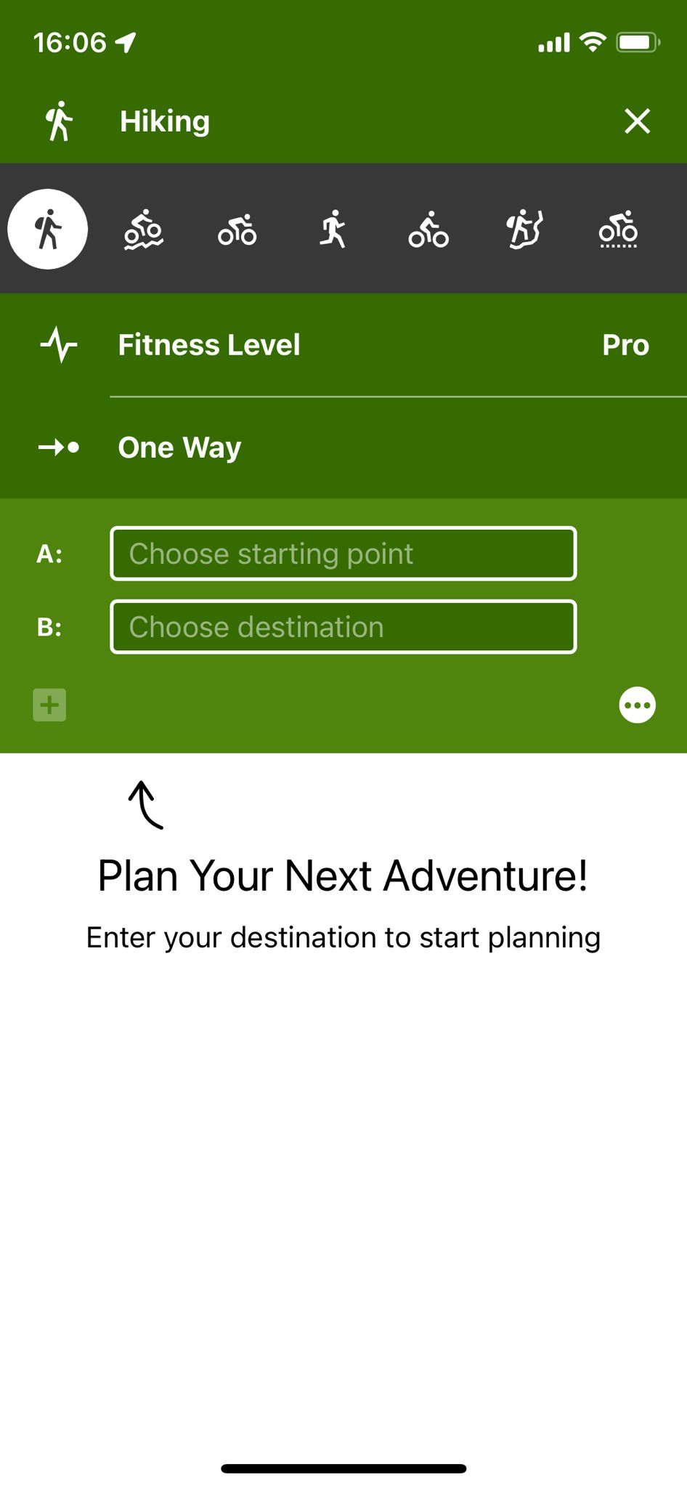
Microinteractions Plan Page
The Plan section of the app allows users to create personalized routes for different activities and Fitness levels. Choosing a starting point leads the user to a screen where they can choose to start from a map or from a search option.
These two microinteractions will be the distinction of newly created alternatives.

Slide 49
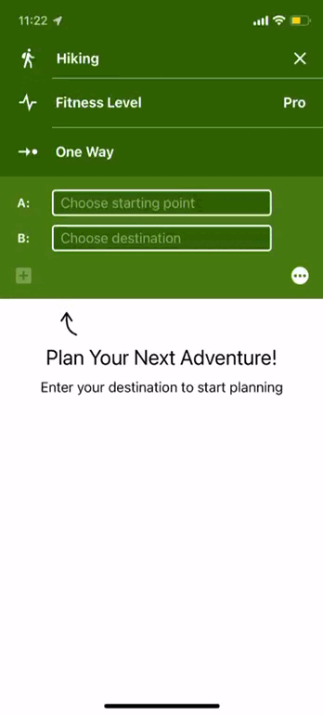
#8
Fitness Level
Plan
original
Description:
Interaction goal:
The Fitness Level is classified in 5 steps by an open-folded progress bar. By clicking - and + the fitness level changes. Starting from Beginner, to Average, In Good Shape, Athletic, Pro.
The Progress bar shows how experienced a user is to create a fitting route for themselves and comparable Komoot users.

Slide 50
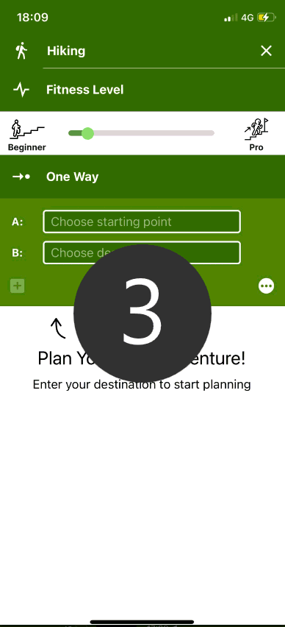
#8.1
Slider
Plan
alternative
Description:
Goal and motivation:
A slider is a more continuous measure of the fitness level, allowing the user to classify themselves less strictly. The application then decides under which category the user falls.
By not classifying the user by name, they have a better chance of estimating themselves. The categorizations can give false beliefs to the user and now it can be more accurately represented. Can be good for the detailed / organized user in terms of completeness.

Slide 51
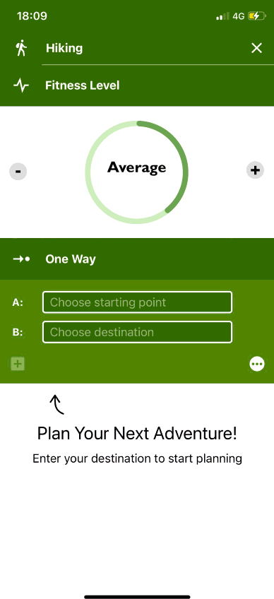
#8.2
Circular Dial
Plan
alternative
Description:
Goal and motivation:
The Circular dial, manipulated by + and - and by rotating the dial to select the desired fitness level. It shows a visual overview.
A visual overview can be better understood by users, as it shows a certain progress, and fits the mental model. Using it the same way as interaction 5.1 contributes to memorability and learnability.

Slide 52
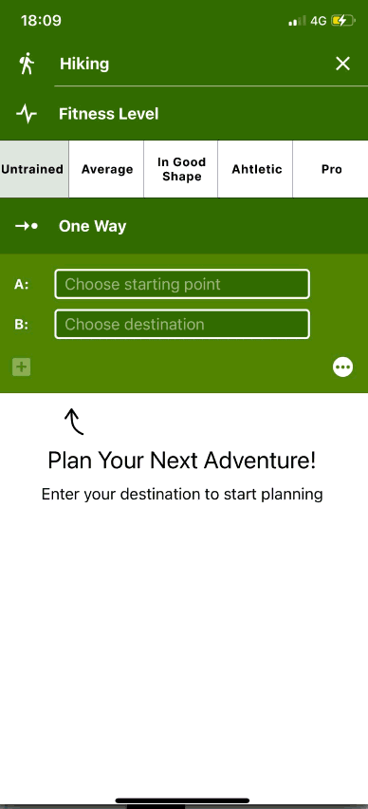
#8.3
Segmented Control
Plan
alternative
Description:
Goal and motivation:
The segmented control shows the different difficulty levels all in a horizontal line. Only one level can be chosen.
When some other microinteractions are also changed to a segmented control this can be more consistent. Also, it shows another way of choosing the fitness level in a certain order from least left to most right.

Slide 53
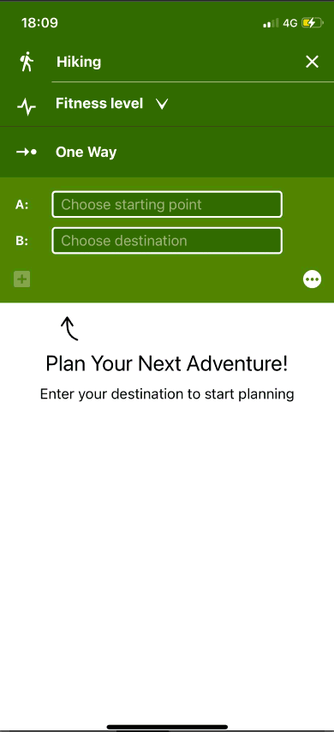
#8.4
Dropdown
Plan
alternative
Description:
Goal and motivation:
A dropdown to show the difficulty levels from untrained (first) to pro (last).
It allows the page to be static, the dropdown only has to be clicked and the options appear, contributing to efficiency.

Slide 54
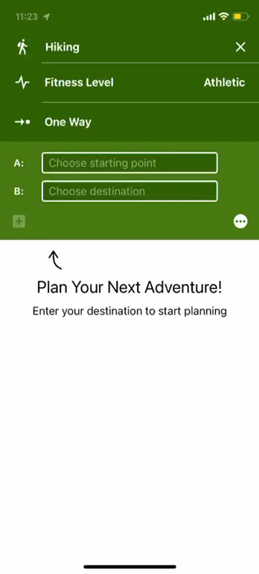
#9
One Way or Round Trip
Plan
original
Description:
Interaction goal:
To determine whether the route should be a one way (from point A to B) or Round Trip (from A to A).
A drop down segment control is used, such that if one is chosen the other cannot be chosen.

Slide 55
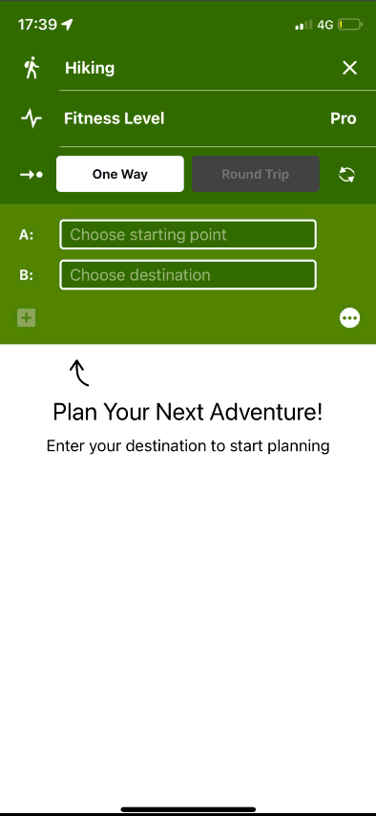
#9.1
Immediate segment control
Plan
alternative
Description:
Goal and motivation:
Taking away the dropdown action, the user can immediately see what route types exist, with as default the One Way.
Using less space and less clicks are necessary, making it more efficient.

Slide 56
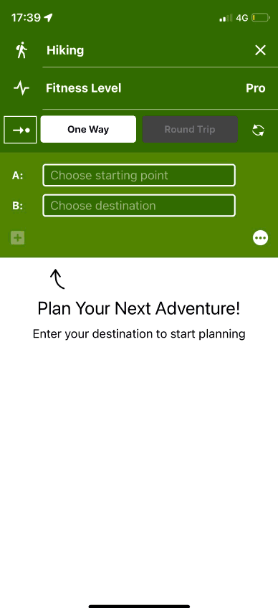
#9.2
Placeholder and error message
Plan
alternative
Description:
Goal and motivation:
The Placeholder for a Round Trip contains the right information so that the user does not get confused. Adding a notification makes sure the user will not try to adjust the destination (which is the same as the starting point).
As the starting point is the same as the beginning point, it should be made clear that the user cannot input the end point anymore. To prevent misunderstanding, a notification is shown with A) Clear Explanation B) Contextual Information and C) Guidance or Solution, preventing errors.

Slide 57
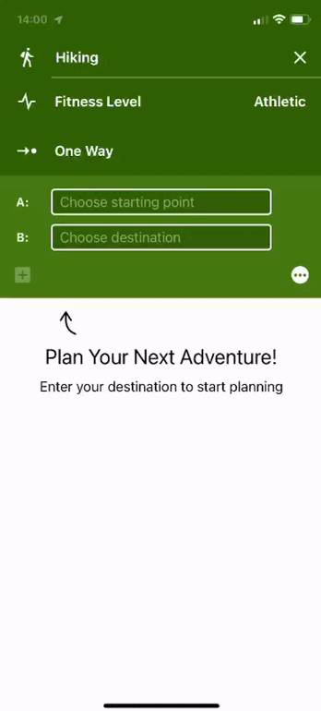
#10
Choose Starting Point (general)
Plan
original
Description:
Interaction goal:
Choosing a starting point starts by selecting the input field A: Choose starting point. From there, the user reaches a new page where there are multiple options to choose a starting point, namely through a search bar or on the map.
These interactions make sure the user has the freedom to choose the way he/she wants to and gives freedom, depending on if the user wants to explore through the map, or has a specific location in mind.

Slide 58
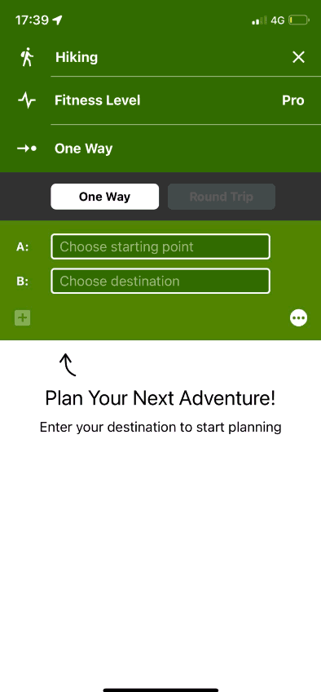
Segmented control
for map or list
#10.1
Plan
alternative
Description:
Goal and motivation:
Going directly to the map where you can switch between the map or a list with more listed information.
This can be perceived less overwhelming and less actions are required. From the map you can Search, leading the user to the list, as well as changing the map to list. It is providing direct feedback on the selection.

Slide 59
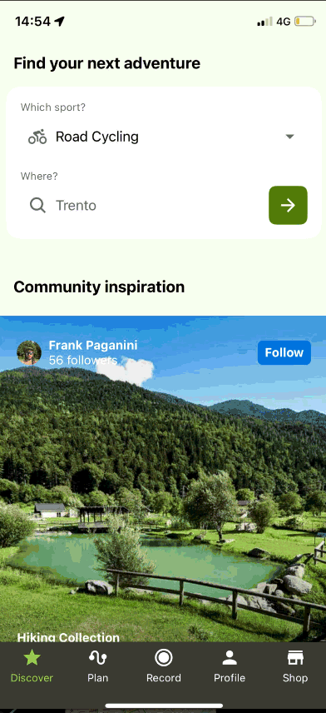
Dropdown route in map
#10.2
Plan
alternative
Description:
Goal and motivation:
Dropdown route shows the start and end point for One way routes and start/mid/start(end) if the user selected a Round trip. This is changing the navigational structure, having the map as default plan page, and still the user is able to search through a search bar.
All information is available in one page and there is less need of switching from page to page, less actions required and there is constant feedback of the route making it a better overview. Then later when filling in the fields, people can recall instead of remember the route, which helps reducing the cognitive load.

Slide 60
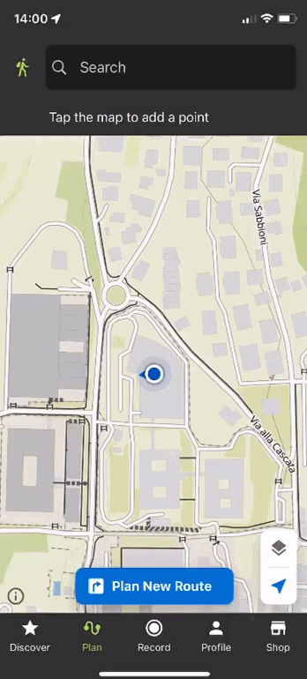
#11
Search Bar
Plan
original
Description:
Interaction goal:
Choosing a starting point can be done by the search bar. There, information is given on certain highlights, saved places and other ways to start from a specific point.
Giving the user many options to find recent searches, and other special places to not being forced to search in one specific way or for a specific input.

Slide 61
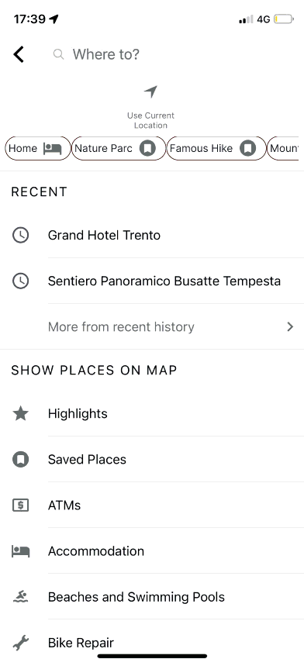
Horizontal scrolling
#11.1
Plan
alternative
Description:
Goal and motivation:
Horizontal scrolling where the user can choose certain places such as pre-selected places (home), or other saved places. Delete waypoint is deleted as this embodies another action than the other three (use location, choose on map or saved places)
Without taking much space, users can access the different options easily. Also they can distinguish the different types of actions, whereas Use Current Location is something else than selecting one of the saved places.

Slide 62
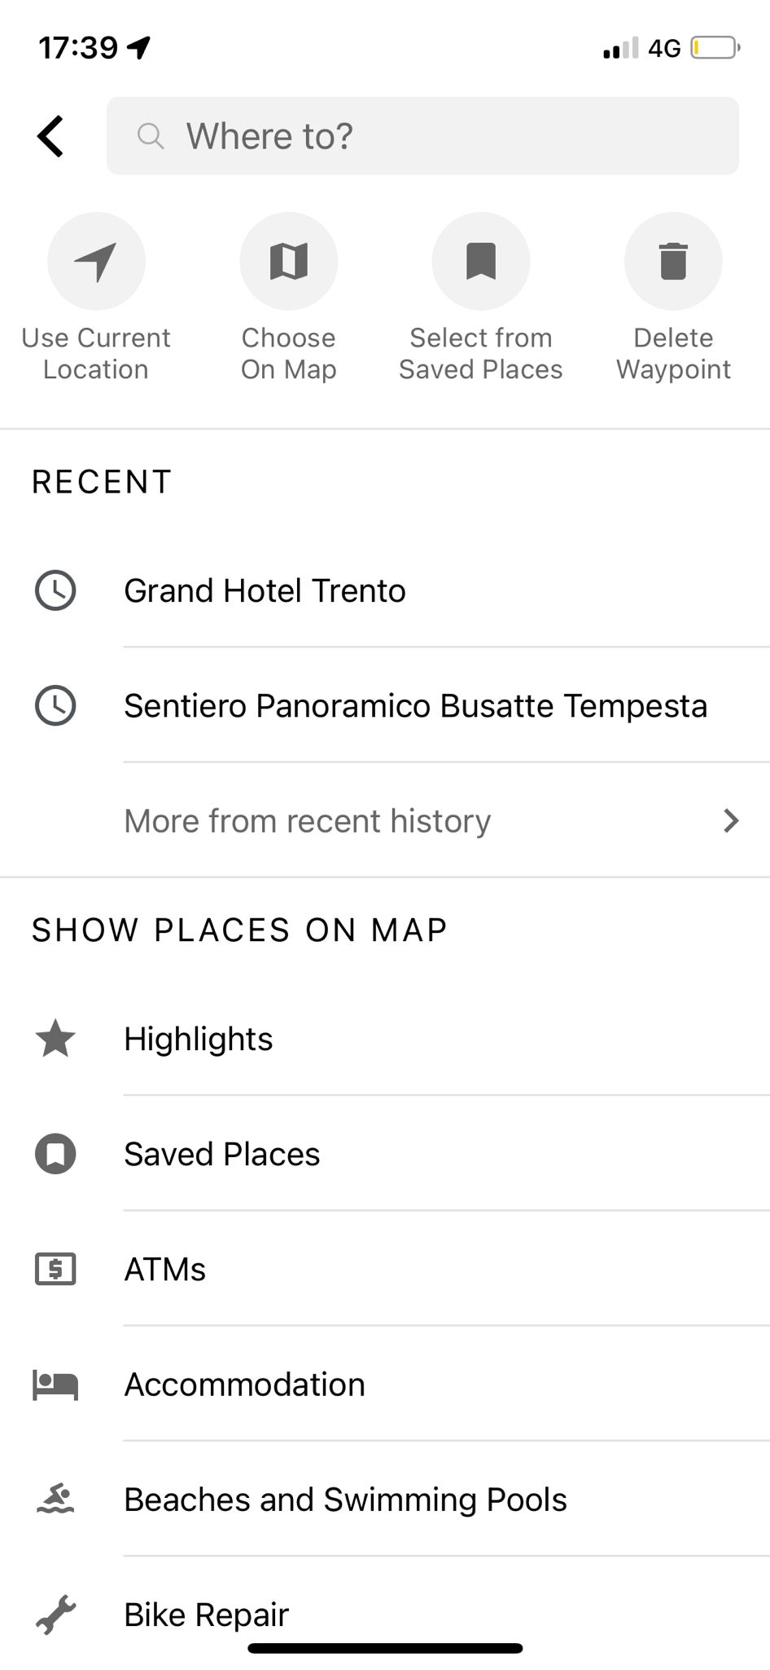
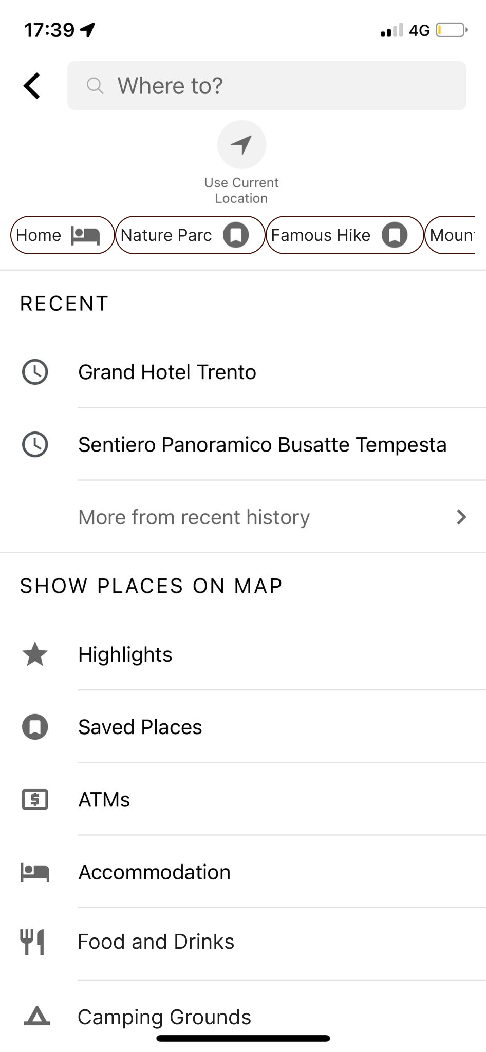
Highlights LATCH
#11.2
Plan
Description:
Goal and motivation:
Putting the “places on map” in order by Hierarchy, in this case most used or most popular by the users.
Assign value or weight to the information; usually on a scale from larger to smaller. This way most people can find the places they want to find the fastest as they are more likely to use these certain locations.

Slide 63

Informative Tooltip
#11.3
Plan
alternative
Description:
Goal and motivation:
Providing help by an i-button and while pressed giving more information about the recent searches and what the user can do or control them.
The "i button" might serve as an educational tooltip, providing users with guidance on how to utilize and benefit from the recent searches feature effectively.
It could offer users more control over their search history and privacy settings, allowing them to view or manage the information associated with their recent searches.

Slide 64


Search LATCH
#11.4
Plan
alternative
Description:
Goal and motivation:
Putting the search outcome in order by Location, from closest to you to further away.
Assign value or weight to the information; usually on a scale from larger to smaller. This way most people can find the places they want to find the fastest as they are more likely to use the locations nearer by.

Slide 65

#12
Search on Map
Plan
original
Description:
Interaction goal:
Choosing a starting point can be done by actions applied on the map. A certain point/highlight can be selected after which the user can put this as start or end point. Only after a start and end point, the user can edit the route.
The original microinteraction enables the user to create a route in a more visual way and each point can be edited into a start and end point.

Slide 66

Special places Horizontal bar
#12.1
Plan
alternative
Description:
Goal and motivation:
The Important places that are available in the list section, should als be available in the map such. This is achieved by horizontal scrolling, comparable to google maps.
Users now don’t have to navigate from one page to the other, making it more efficient and more accessible to find the places they need.

Slide 67

LATCH - Hierarchical
#12.1b
Plan
alternative
Description:
Goal and motivation:
Putting the “places on map” in order by Hierarchy, in this case most used or most popular by the users.
Assign value or weight to the information; usually on a scale from larger to smaller. This way most people can find the places they want to find the fastest as they are more likely to use these certain locations.

Slide 68

Visual Click-responsive Highlight
#12.2
Plan
alternative
Description:
Goal and motivation:
Showing popular places by the Komoot community. By hovering over makes the star bigger, and when clicking, the user can add the point as start or end of their route.
This can make it easier especially for “on-the-go” users to make easy decisions on where to start their route, because other activity Komoot users have mentioned this as one of their most favorite highlights.

Slide 69

#13
Manipulate existing route
Plan
original
Description:
Interaction goal:
By pressing the the option button at the right in the corner, five options to manipulate the existing route exist, using a dropdown menu with bottom sheet overlay menu. The option are: Adjust a route, Reverse Direction, See full Profile, Save and Send, and Scrap Route shown in red letters.
Using this microinteraction enables the user to have a full map screen, thus taking up less space. All actions have to do with the existing route, however they are different types of actions.

Slide 70

Buttons
#13.1
Plan
alternative
Description:
Goal and motivation:
The buttons with their linked actions are always available such that the actions can always be fulfilled by the user.
Users always have the options available, so when they need to do any action with the route, they can do it any time. Makes it more apparent.

Slide 71

Dropdown
#13.2
Plan
alternative
Description:
Goal and motivation:
A dropdown menu with the same functionalities as before. When this is not the action preferred it can be closed by the same button that it opened with or by pressing at any other place on the screen. For delete, the background is adjusted to a red background to show the action has big impact.
Enables the user to keep the action closer to the opening of the menu and takes even up less space. The red color is for the user not to make any intentional actions, and to remind themselves this action can be more impactful.

Slide 72

Icon dropdown
#13.2b
Plan
alternative
Description:
Goal and motivation:
A dropdown including icons, while hovering over them showing also the action in text. This can make it easier for the user to imagine what the action is.
To show information more visually can make the decision process easier and to put less effort in manipulating the route, also taking in less space. The bin icon is colored red to give visual feedback and warns that it is a more impactful action.

Slide 73

Drag and drop
#13.3
Plan
alternative
Description:
Goal and motivation:
Users can delete an item by dragging it to a designated "delete" area or icon. Upon successful dragging and dropping, the item is removed from the interface, providing a visual confirmation of deletion.
The drag-and-drop microinteraction for deleting offers an intuitive and visually confirming method, allowing users to efficiently remove items with a familiar gesture which makes it easier for learnability.

Slide 74

#14
Edit / Adjust route
Plan
original
Description:
Interaction goal:
Starting from microinteraction 13, the dropdown menu with bottom sheet overlay menu appears. From there, the user can select “Adjust route” bringing them to another page. There the user can change the start and end point, and add a middle point. Also the user can see some information on the route.
Bringing the user to another page shows that the user can do many actions: adjust the route but also looking into other useful information.

Slide 75

Dropdown editable waypoints
#14.1
Plan
alternative
Description:
Goal and motivation:
When enabling a dropdown, similar to microinteraction 10.2 from where you can not only put a start or destination point, but also intermediate waypoints, allows the user to edit the route right away without navigating to another page. The waypoints can be selected on the map or the search bar connected to the waypoint.
It is more conform other navigational apps making it easier for learnability. Also, the user can always look into the created route so far making it easier to recall instead memorize. Then, this microinteraction creates a lot of freedom for the user.

Slide 76

Providing information button
#14.1b
Plan
alternative
Description:
Goal and motivation:
When the user is new to the application, they can find information buttons throughout some parts of the app. Here the information explains that the user can edit or add waypoints.
Providing extra information reduces cognitive load and contributes to learnability. It contains what the section entails, a possible action the user can do and additional information to provide all the help needed.

Slide 77

Direct Manipulation Dragging
#14.2
Plan
alternative
Description:
Goal and motivation:
Direct manipulation on a map to edit the route involves allowing users to physically interact with the map interface to make real-time adjustments to their route. Users can drag the route line or waypoints on the map, dynamically shaping the path according to their preferences
Direct Manipulation to edit the route makes the interface more interactive and gives the user freedom to explore around on how routes can be created.

Slide 78

Record Page
The Record Page enables users to record their route from their location.
The user can pause and finish their routes, change maps, take pictures on the route and share real-time location with live tracking.

Slide 79

#15
Record and pause route
Record
original
Description:
Interaction goal:
First the user has to select the right sport to start the recording session. Then, when pushing the record button it is possible by using the Controls to Pause or Finish the Tour. This is a big pop-up page that covers the entire map. No feedback is provided while doing one of these actions and the finished tour is not visible anywhere. The recording button is a clear Call-To-Action.
The record button is a clear sign to start. Then, the controls show multiple ways for the user to manipulate the record session, with the most clear buttons pause and finish as they are most relevant.

Slide 80

Expandable Bottom Bar
#15.1
Record
alternative
Description:
Goal and motivation:
Instead of covering the whole page, this microinteraction opens the controls just at the bottom of the page such that the user does not have to navigate to another place. The microinteraction is an expandable bottom bar.
It is a more direct action and needs less, making the most relevant functions more easily accessible. The Call-to-Action is important here as it contains the main-functionality and should not be covered by navigating to another page. The red color when selected shows visual feedback on the user’s action (pause).

Slide 81

Segment Control
#15.2
Plan
alternative
Description:
Goal and motivation:
A segment control where the user can switch from recording to pausing to finishing, only one of these actions is allowed. The mapping is based on the most important namely to record (middle, default).
Using a Segment Control for recording, pausing, and finishing a route motivates by providing a clear, compact, and intuitive interface, allowing users to seamlessly switch between recording states with immediate visual feedback.

Slide 82

Feedback Finished Tour
#15.3
Plan
alternative
Description:
Goal and motivation:
Once the user finishes the tour, it could be that the user made a mistake. Feedback is needed for the user not making the wrong decision, and after that, to give some confirmation when the tour is finished successfully.
This is needed for error prevention and making it clear for the user what the consequences of their action is.

Slide 83

Feedback Finished Tour Default
#15.3b
Plan
alternative
Description:
Goal and motivation:
Once the user really finishes the tour, the user can see the statistics about the tour in another page. The default option is bold and in another color such that the user is steered towards making that choice.
As a user usually you want to see the route right after you recorded it. Currently, it is hard to find the tour back in the app. By providing this default selection the user has to think shorter, reducing cognitive load.

Slide 84
Microinteractions Redesign
Mobile Application Komoot
Prototyping of Interactive Systems
18th of January, 2024
Iris de Wit

